Slide 1
Research question:
Solution:
1. Benefit of normalization(extreme point search) in steady state optimization
For 2 objective problem, can use extreme point search.
For more than 2 objective problem, can use corner point search
Expected behaviour:
Better diversity for steady state strategy
Deal with typical ND normalization problems
Shrinking normalization bound (ND search over the process can commonly cause normalization bound shrink )
Slow convergence speed(initialization faraway)

Slide 2
Result Saving Structure
Results Processing Structure
Nd_seed_x.csv
Finally ND front of this run
Results_convert.csv
Generated from paper1_resconvert.py
List the normalized HV value (from PF)
each row for each seed
3 columns (3 compared methods) a group
From this file can have normalization results understanding
Hvcong_seed_x.csv
2 columns structure
Column1: PF
Column2: ND over each iteration
Trainy_seed_x.csv
All evaluated F values over the process( should be the number of set FEs)

Slide 3
How to check whether the corner search improves ND bounds?
There is need to check corner search’s boundary has landed in the right locations
After corner search, check whether new ND fronts’ any min value has dropped

Slide 4
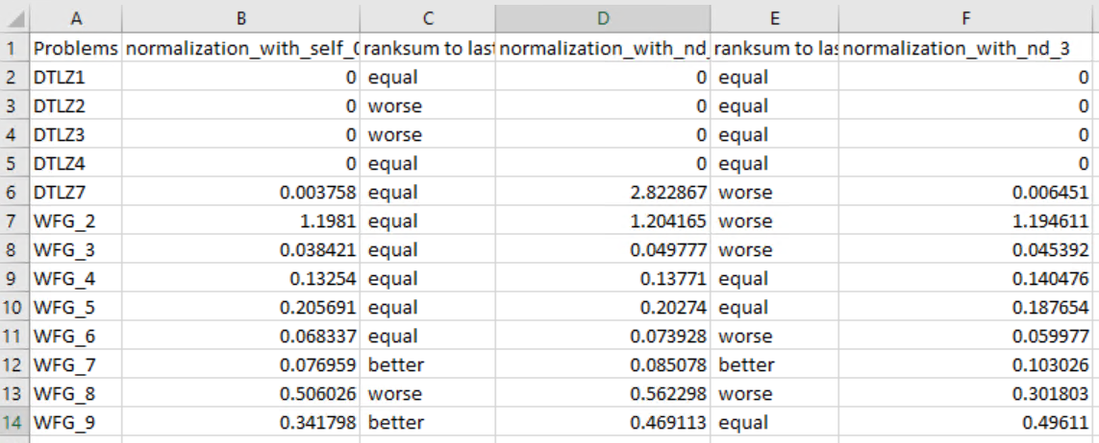
Observation
evidence
Ideal point search is successful in terms of improve ideal point compared to other two methods
Significant test in file ‘ideal_distance_compare.csv’
Columns show median Euclidean distance between final ideal point and PF ideal point over 29 runs.
Significant test is compared to extreme point algorithm
Worse means the left algorithm is worse

Slide 5
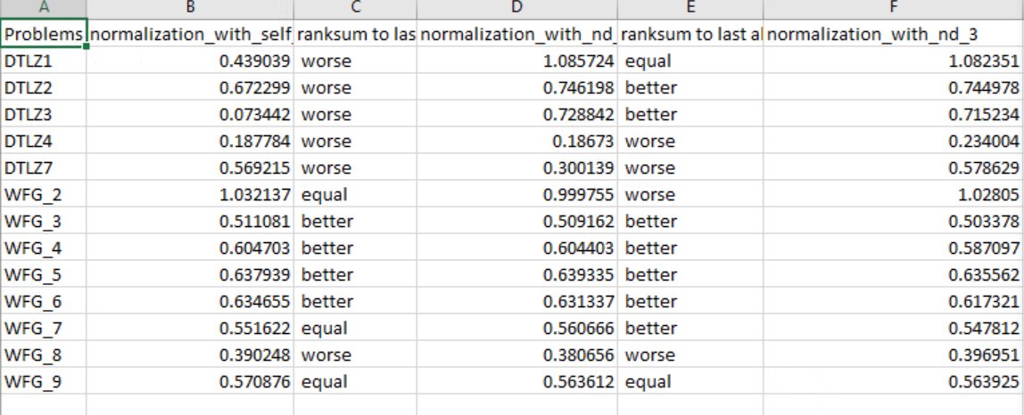
Observation
evidence
HV performance does not consistently improve with ideal point and Nadir improvement
Significant test in file ‘result_lean_sig.csv’
Median HV value of final results over 29 runs.
Significant test is compared to extreme point algorithm
Better means the left algorithm is better in terms of HV indicator of final results

Slide 6
Ideal performance
Analysis: although extreme point search served its purpose in terms of bringing the final ideal point closer to real ideal point, final performance became worse in terms of HV performance. There are two reasons behind this contradictive performance:
[1] Nadir point influence, HV performance also depends on nadir points move to right position. If with extreme point search, nadir point can move from a position far from real nadir point to a closer position, then the hv performance can improve. If Nadir position does not improve much during the search, then the following behaviour will affect final performance
[2] Imbalanced contribution of ND points on HV performance. Steady state infill search has relatively scarce points on ND front due to expensive problem nature. An infill point located in the middle of ND front has better hv improvement. Extreme point search force selecting points with less HV contribution. Eventually might compromise final performance
HV performance

Slide 7
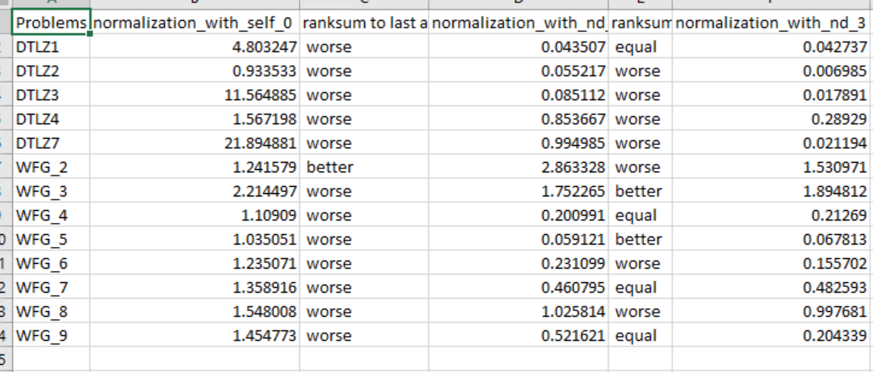
HV performance
Points need to be explained
[1] DTLZ2, scheme(3) has better nadir, equal ideal, but over all performance worse than scheme (2)
[2] DTLZ4 scheme(3) has better nadir, equal ideal, but overall performance better than scheme (2)
[3] WFG4, scheme (3) has equal nadir, equal ideal, but worse all performance than scheme (2)
[4] WFG6, scheme (3) has better nadir, better ideal, but still worse overall performance
Ideal performance
Nadir performance

Slide 8
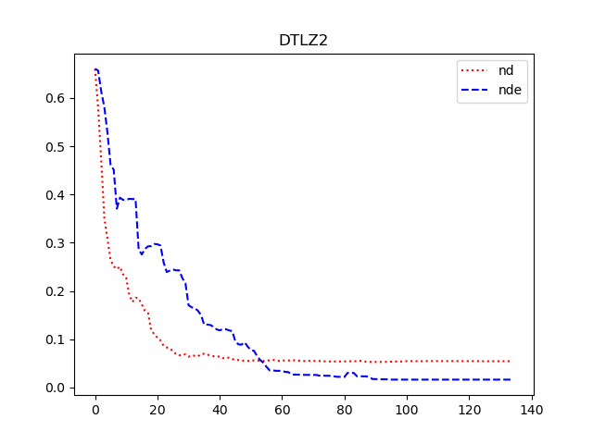
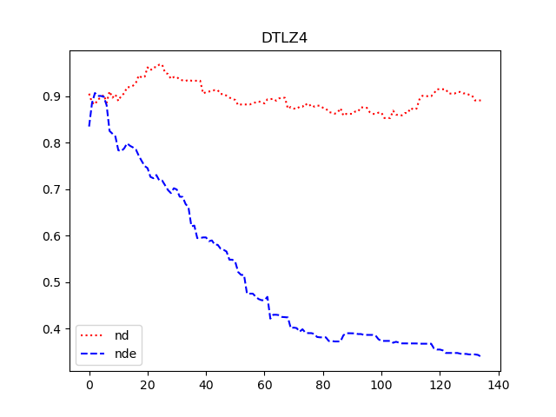
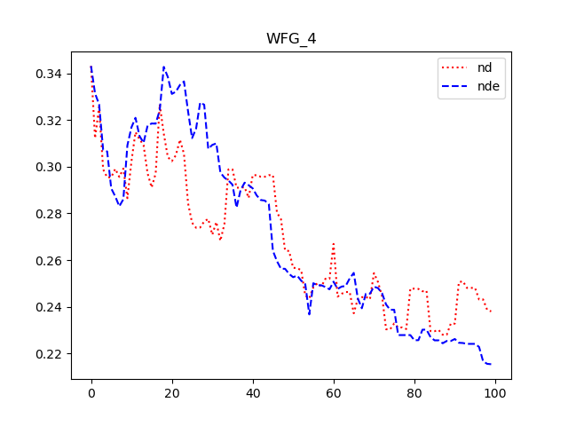
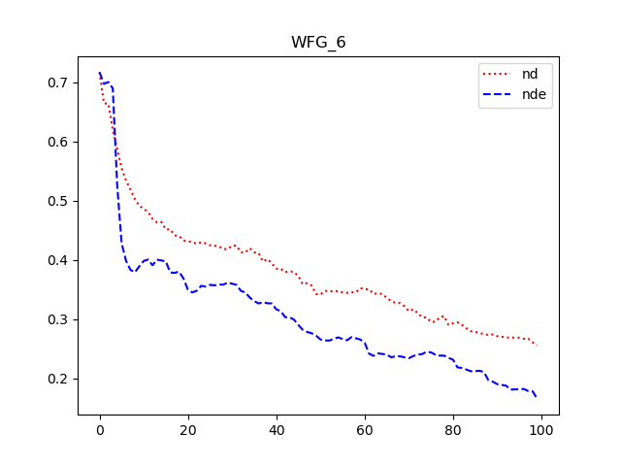
Points need to be explained
[1] DTLZ2, scheme(3) has better nadir, equal ideal, but over all performance worse than scheme (2)
[2] DTLZ4 scheme(3) has better nadir, equal ideal, but overall performance better than scheme (2)
[3] WFG4, scheme (3) has equal nadir, equal ideal, but worse all performance than scheme (2)
[4] WFG6, scheme (3) has better nadir, better ideal, but still worse overall performance
[1-2] These two is interesting as same significant test results on nadir and ideal, but opposite performance on overall HV indicator. Check nadir plot (distance to real nadir point) side by side, we can infer that the marginal benefit from improved nadir point does not compensate the performance drawback on reinforcing corner points evaluation
[3] It is relatively easier to explain WFG4, if no improvement on nadir or ideal, reinforcing corner point evaluation will hinder overall performance
[4] The plot is mean plot, previous significant test is on median, but if we look at DTLZ4 and WFG6 side by side, we can infer that the improvement on nadir and idea does no compensate the loss on corner point evaluation

Slide 9
What to do with this situation? Can any improvement be made?
Therefore to counterbalance this situation, corner search needs to use less corner points for evaluation, or adaptively use less corner evaluation when the initial nadir point is not in the outer space of /general far away from the real nadir point
Two interacting factors play in the performance, one is problem nature (i.e. whether nadir point is difficult to approximate); the other is corner search has double blade effect. In steady state optimization, due to scarce points, infill points in the middle has better HV contribution, while infill points on the corner has less HV contribution. Enforcing corner points evaluation may sacrifice HV improvement.
Improvement possibility
How?
Only evaluate one point on the ideal improved objective? The ideal of corner/extreme point search is to adjust normalization bound, so does one point evaluation serve this purpose? What can be used to guide adaptation? Adaptation to being satisfied with current nadir point?
When to evaluate ?
Why/which one to evaluate?

Slide 10
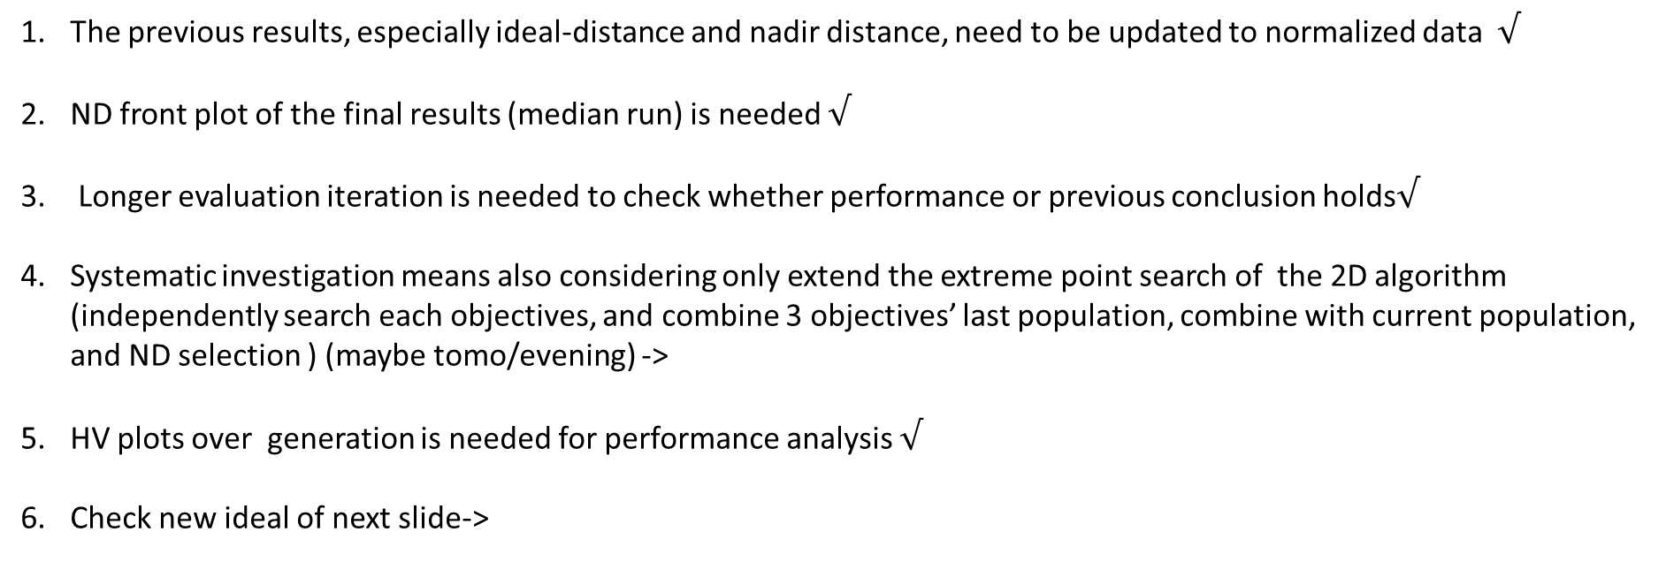
Updates and re-explain
The previous results, especially ideal-distance and nadir distance, need to be updated to normalized data $√$
ND front plot of the final results (median run) is needed $√$
Longer evaluation iteration is needed to check whether performance or previous conclusion holds$√$
Systematic investigation means also considering only extend the extreme point search of the 2D algorithm (independently search each objectives, and combine 3 objectives’ last population, combine with current population, and ND selection ) (maybe tomo/evening) ->
HV plots over generation is needed for performance analysis $√$
Check new ideal of next slide->

Slide 11
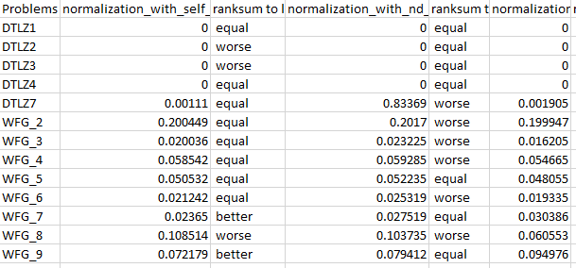
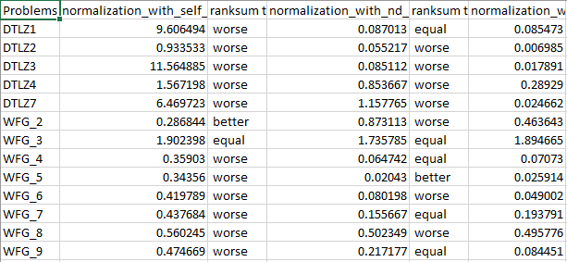
Side by side check with normalization
After normalization, more problems, corner search improves Ideal distance
Ideal performance origin space
Ideal performance Norm space
After normalization, corner search consistent with no normalization
Nadir performance origin space
Nadir performance Norm space

Slide 12
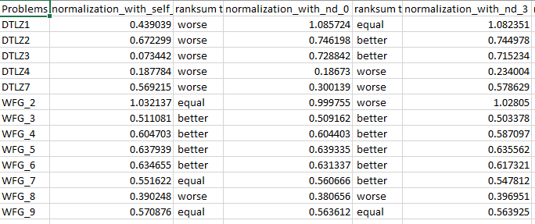
HV performance
Previous observation cases still holds
[1] DTLZ2, scheme(3) has better nadir, equal ideal, but over all performance worse than scheme (2)
[2] DTLZ4 scheme(3) has better nadir, equal ideal, but overall performance better than scheme (2)
[3] WFG4, scheme (3) has equal nadir, better ideal, but worse all performance than scheme (2)
[4] WFG6, scheme (3) has better nadir, better ideal, but still worse overall performance
Ideal performance
Nadir performance

Slide 13
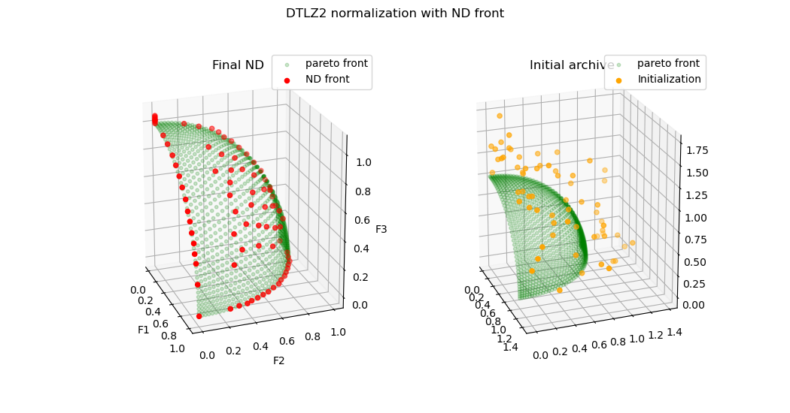
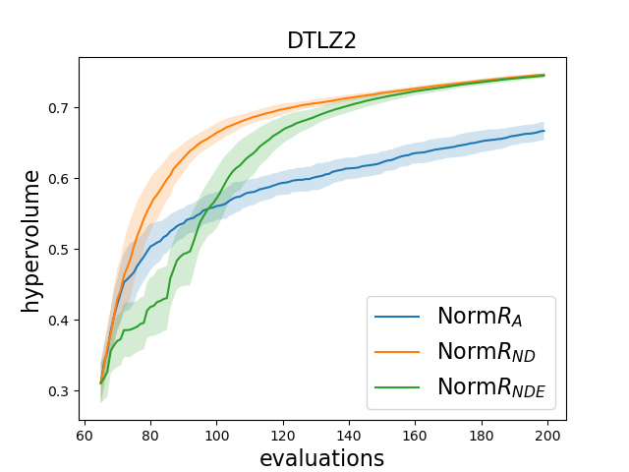
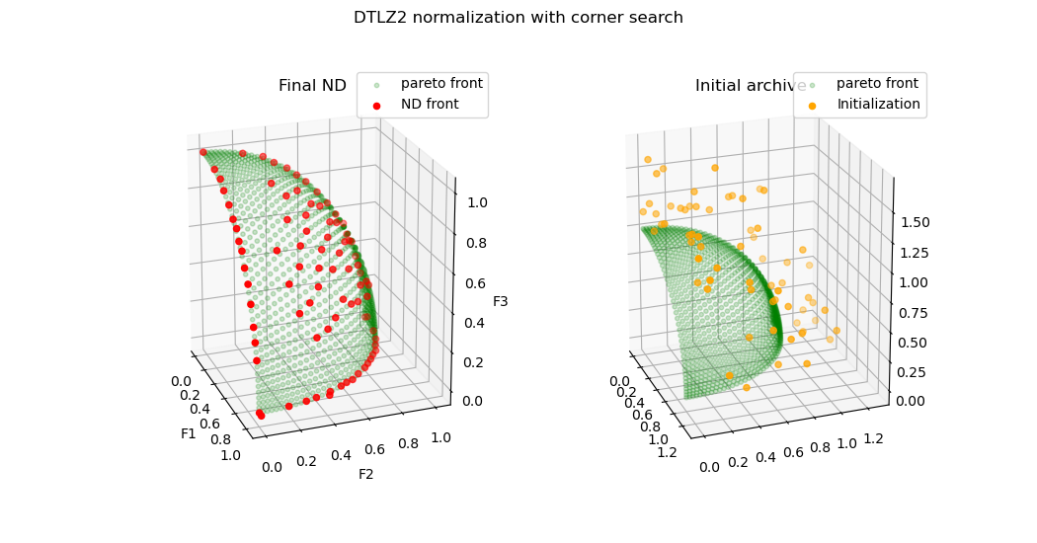
With ND performance
[1] DTLZ2, scheme(3) has better nadir, equal ideal, but over all performance worse than scheme (2)

Slide 14
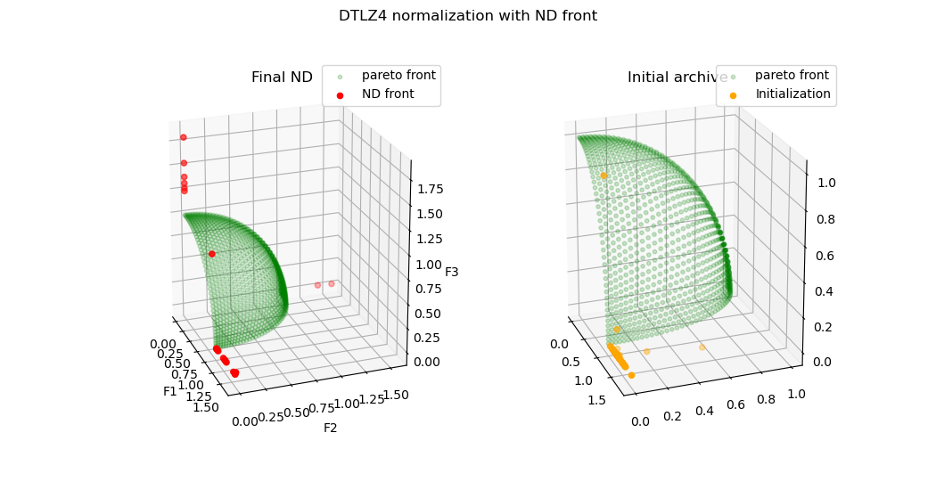
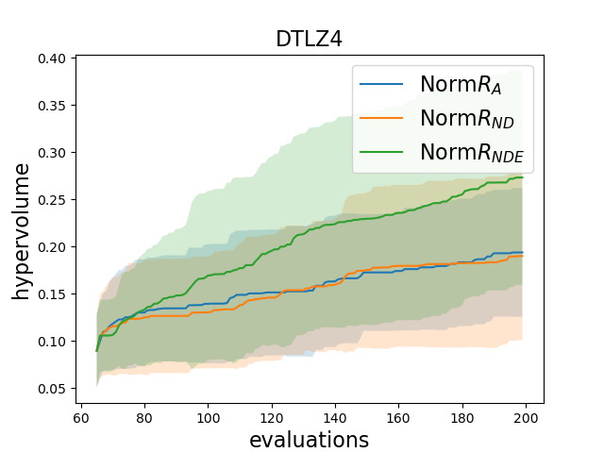
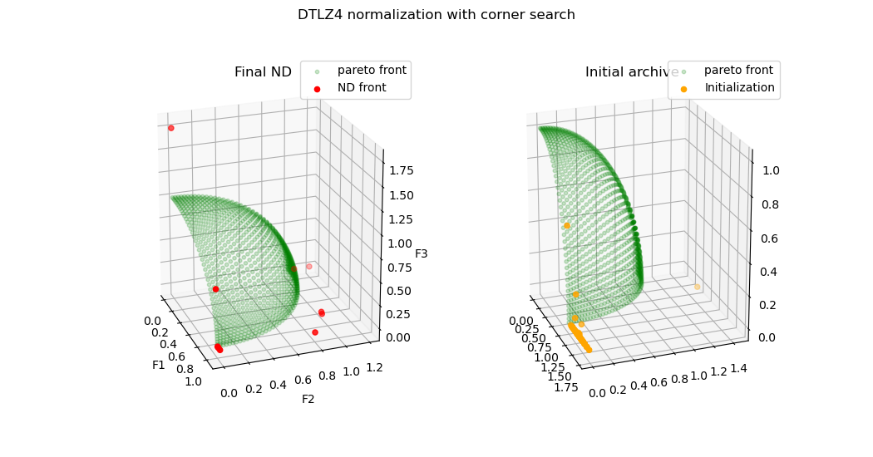
With ND performance
[2] DTLZ4 scheme(3) has better nadir, equal ideal, but overall performance better than scheme (2)

Slide 15
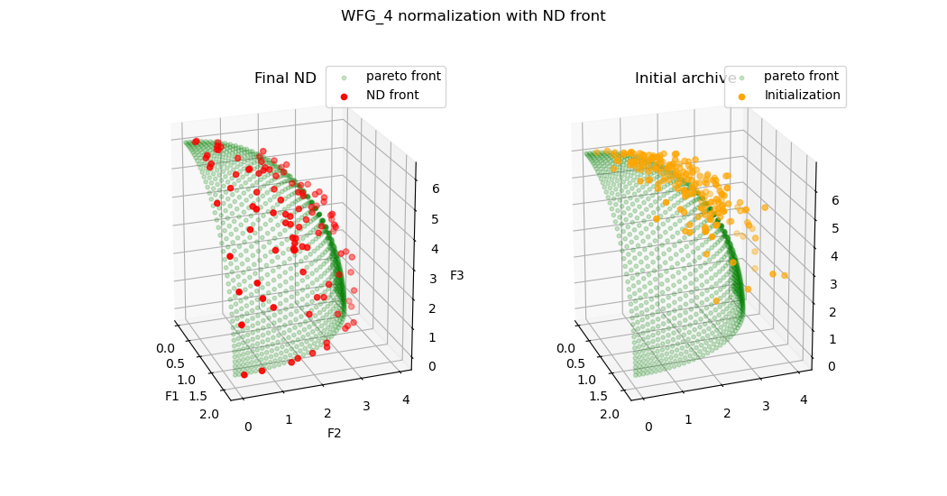
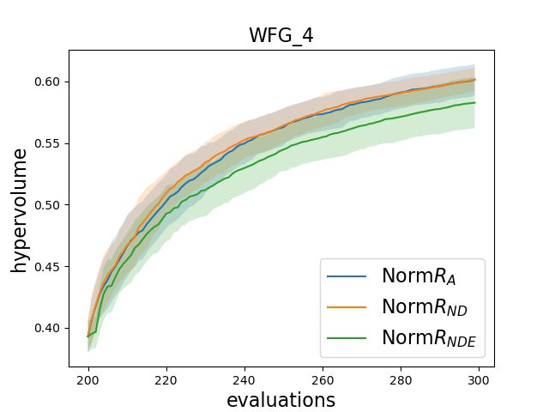
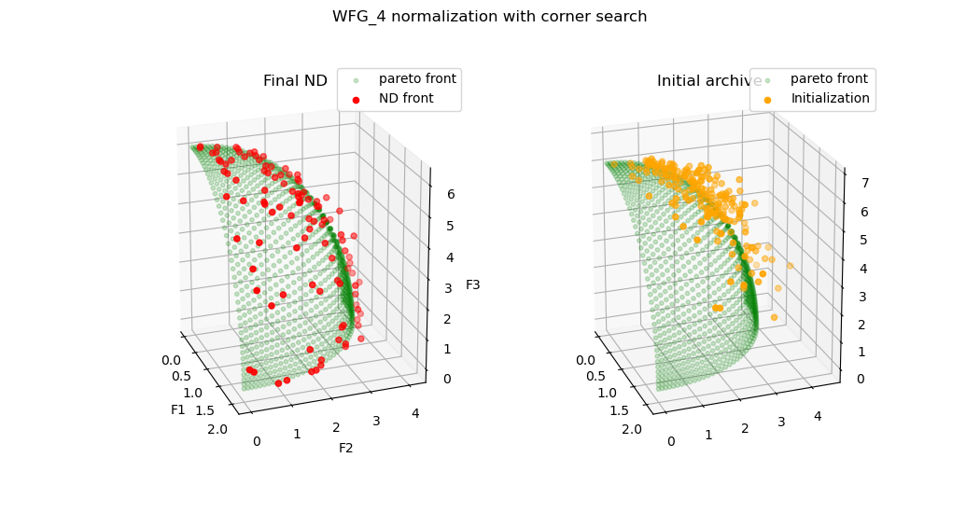
With ND performance
[3] WFG4, scheme (3) has equal nadir, better ideal, but worse all performance than scheme (2)

Slide 16
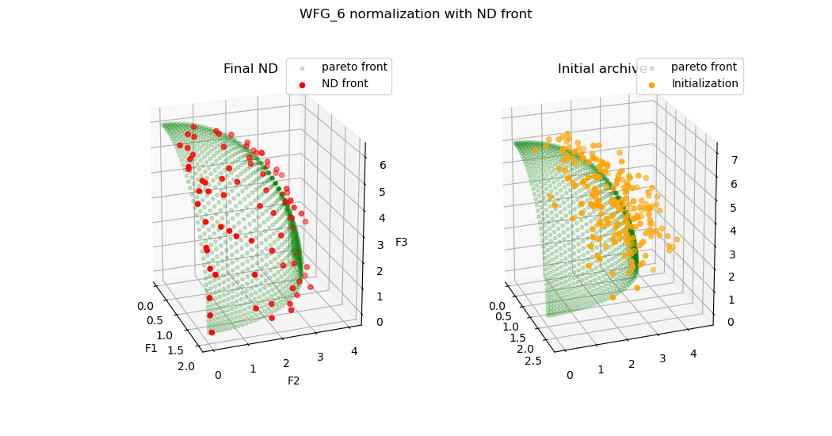
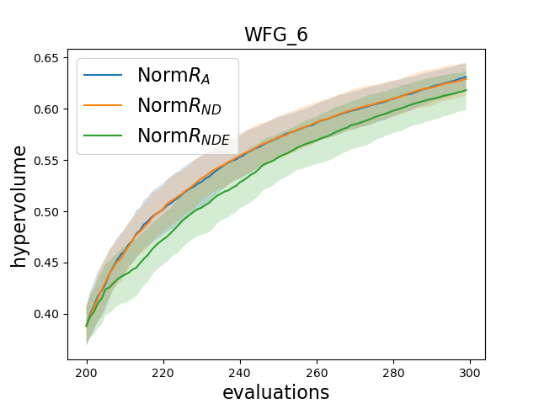
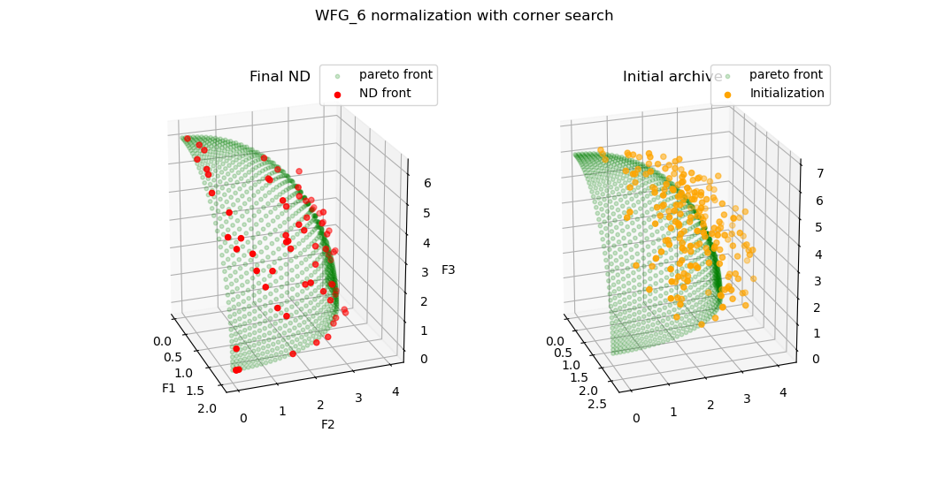
With ND performance
[4] WFG6, scheme (3) has better nadir, better ideal, but still worse overall performance

Slide 17
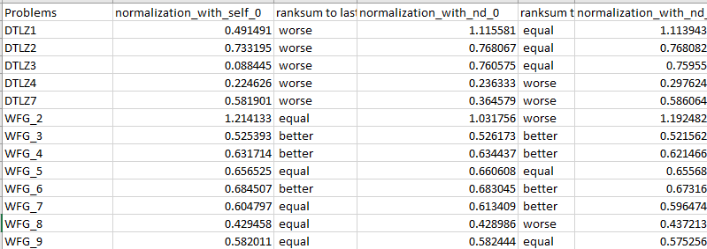
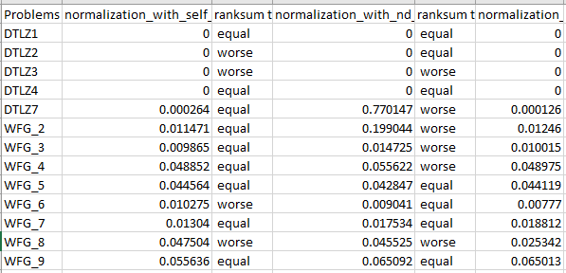
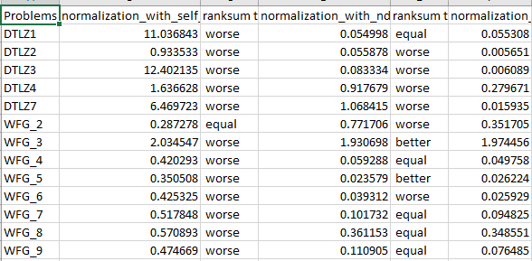
Performance with increased evaluation budget
HV performance
Ideal performance
Nadir performance

Slide 18
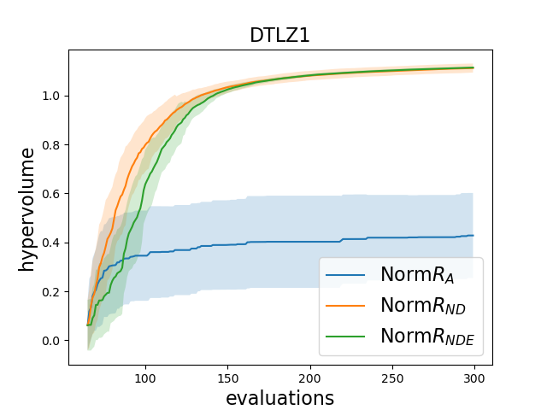
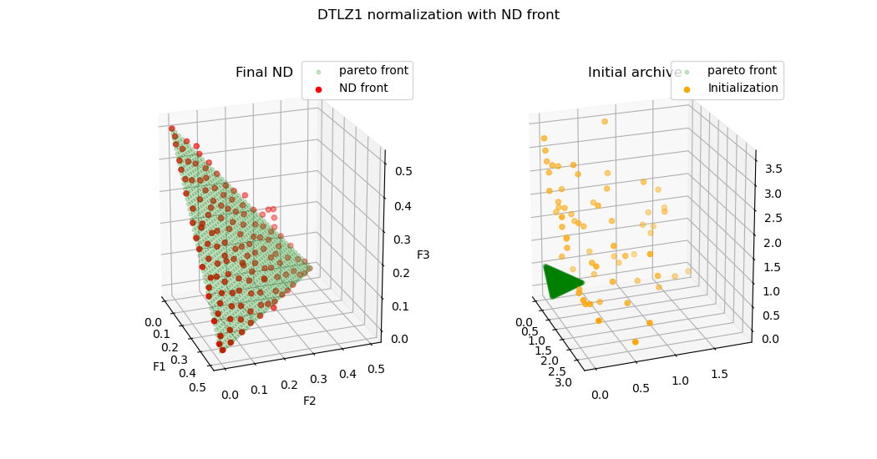
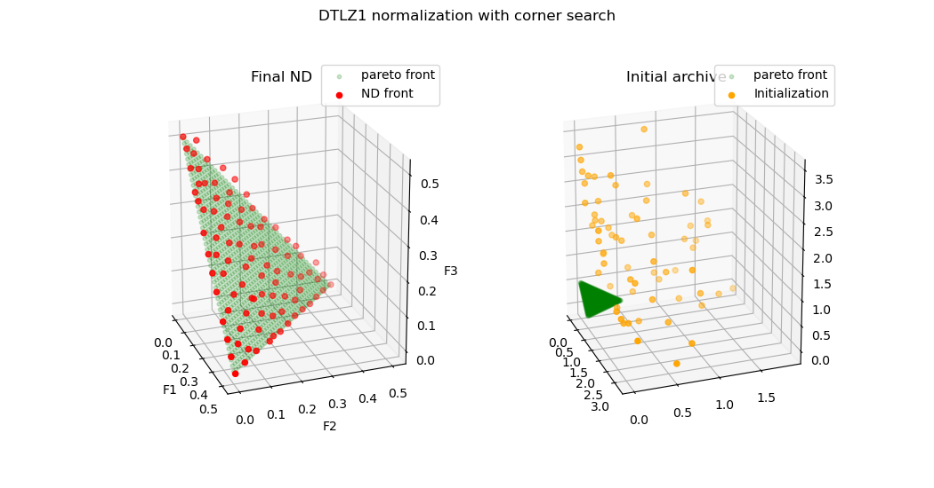
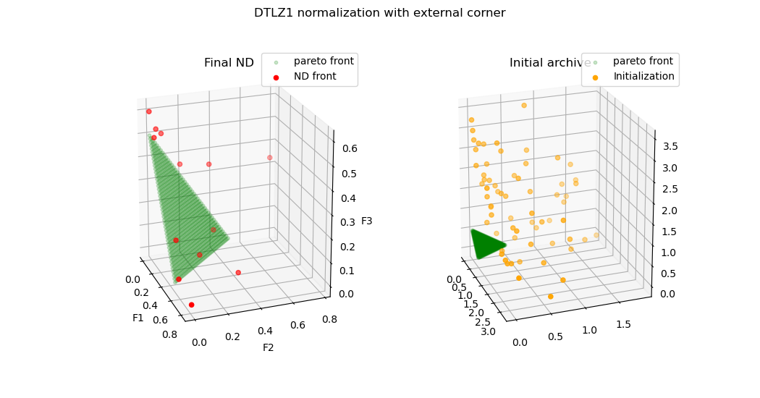

Slide 19
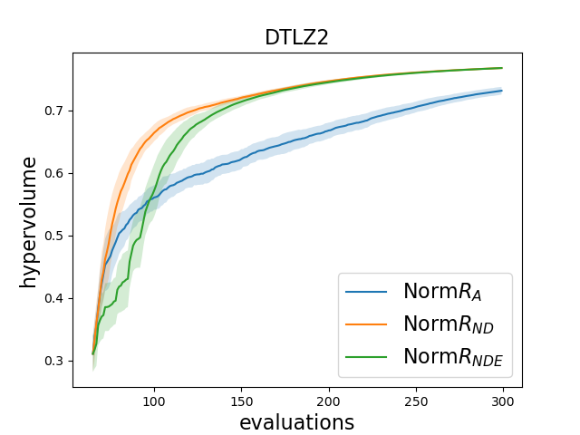
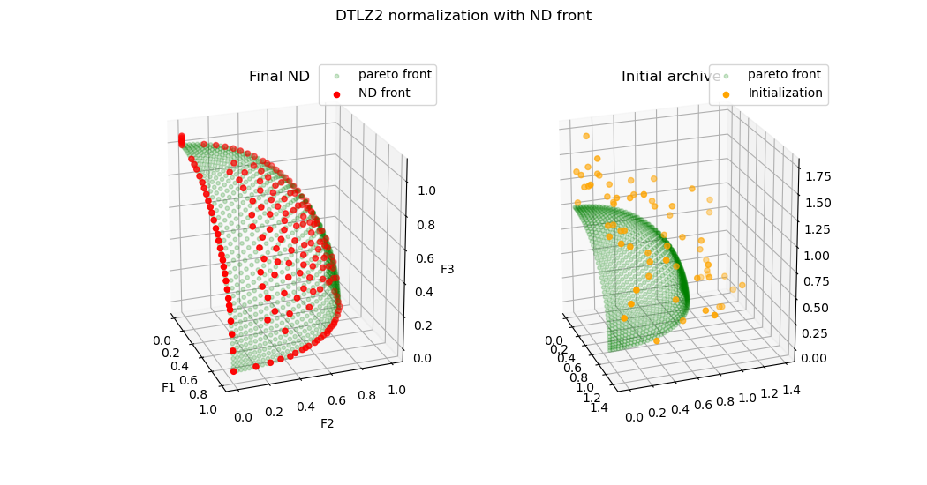
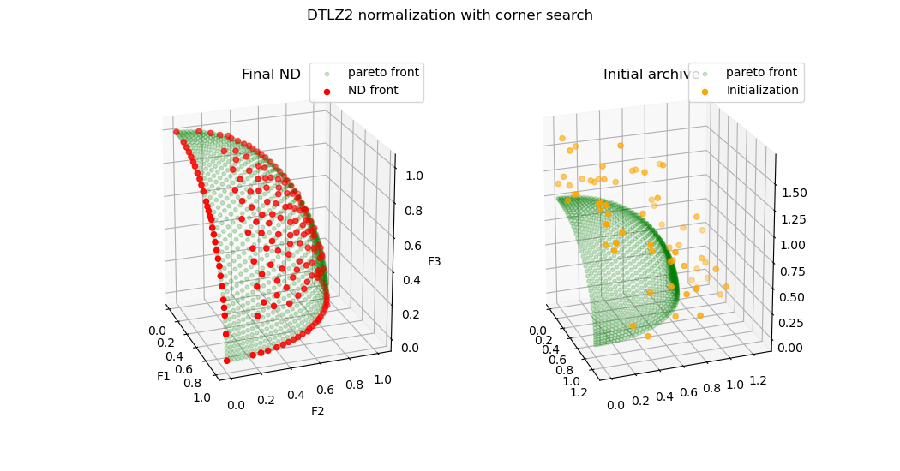
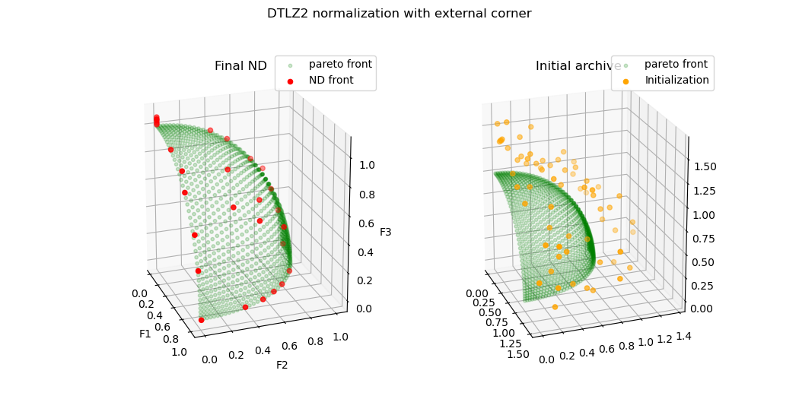

Slide 20
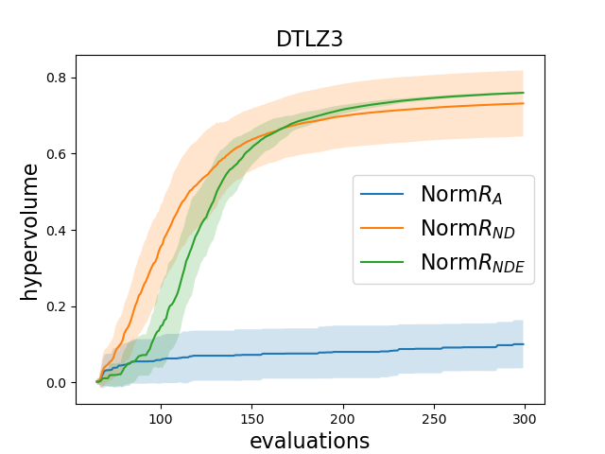
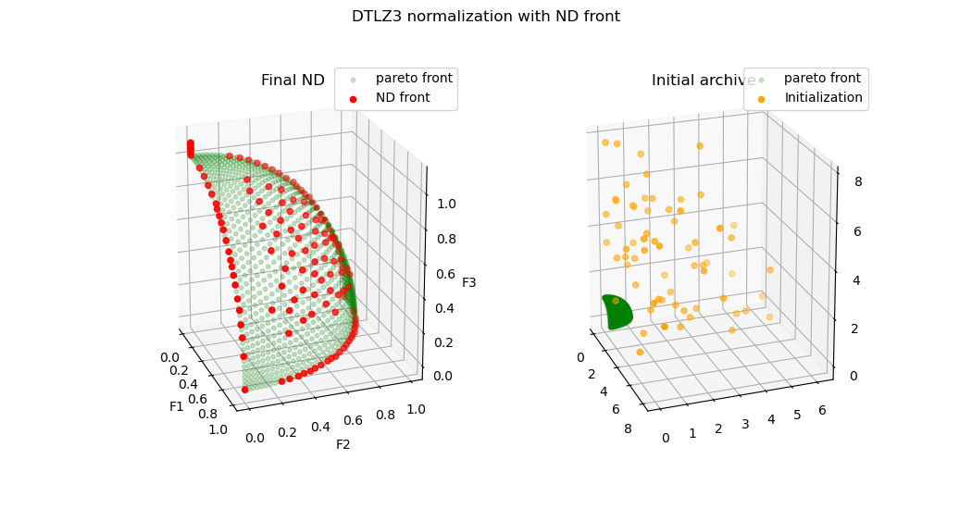
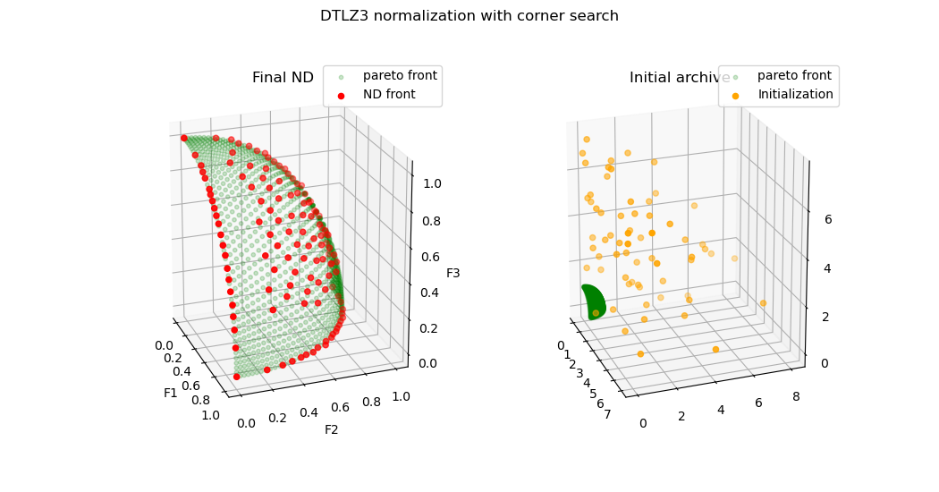
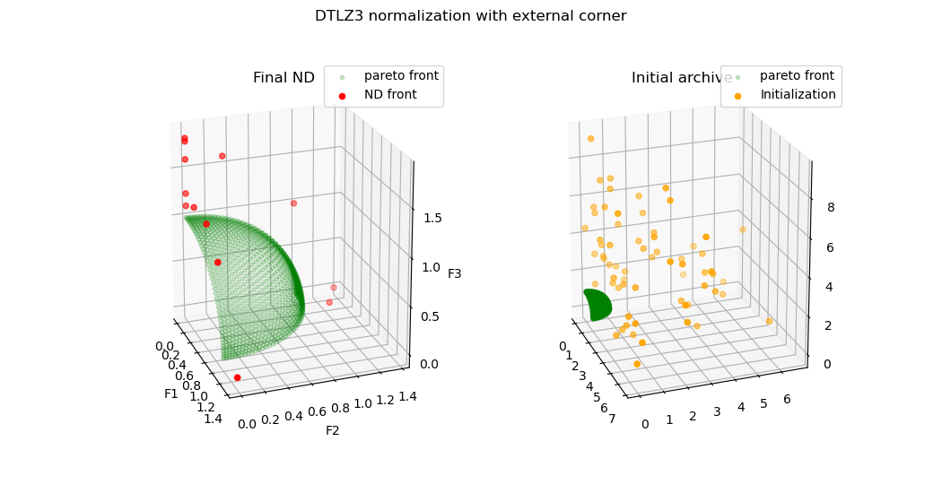

Slide 21
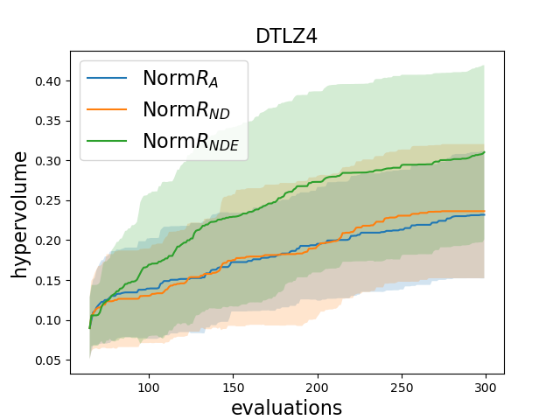
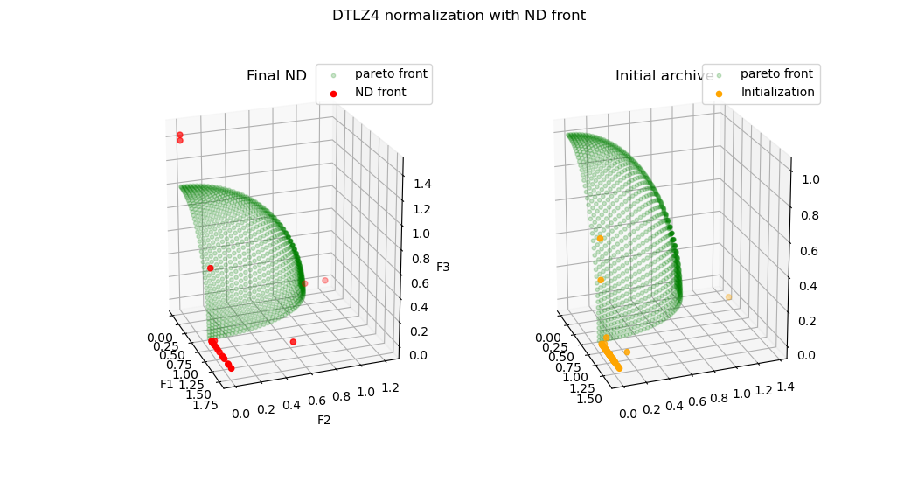
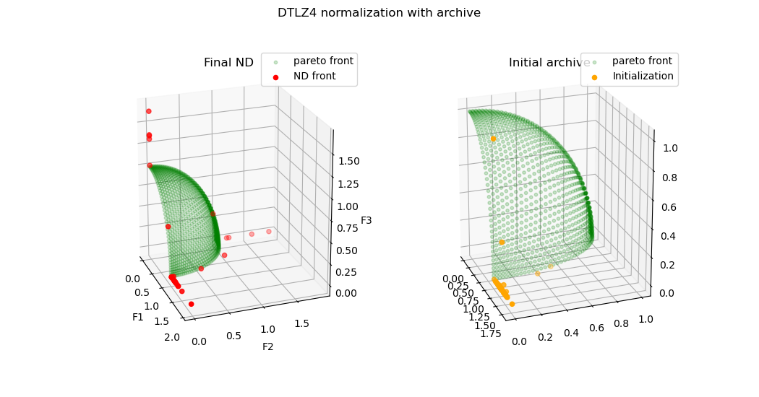
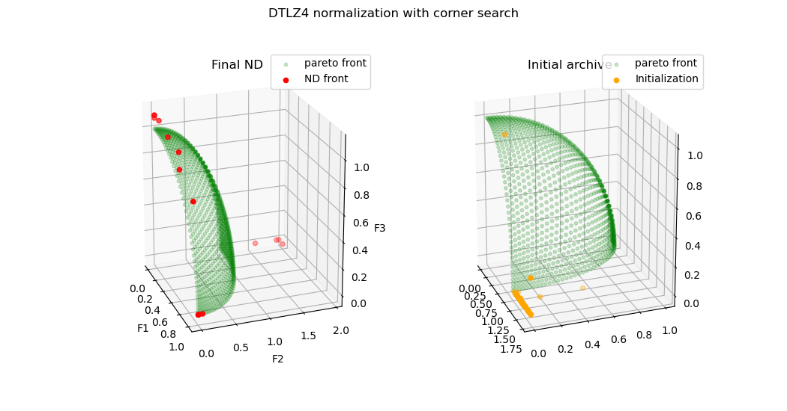

Slide 22
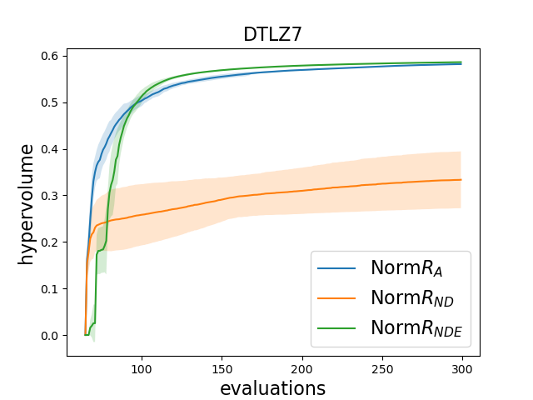
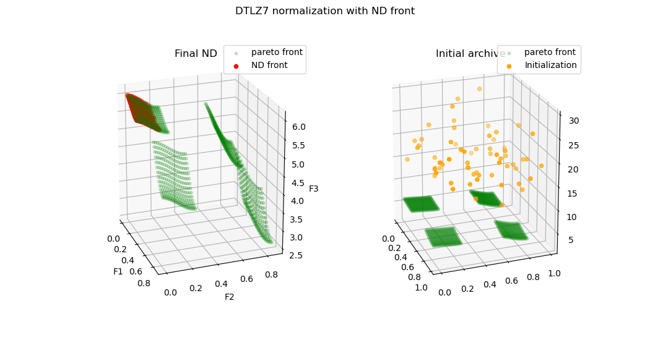
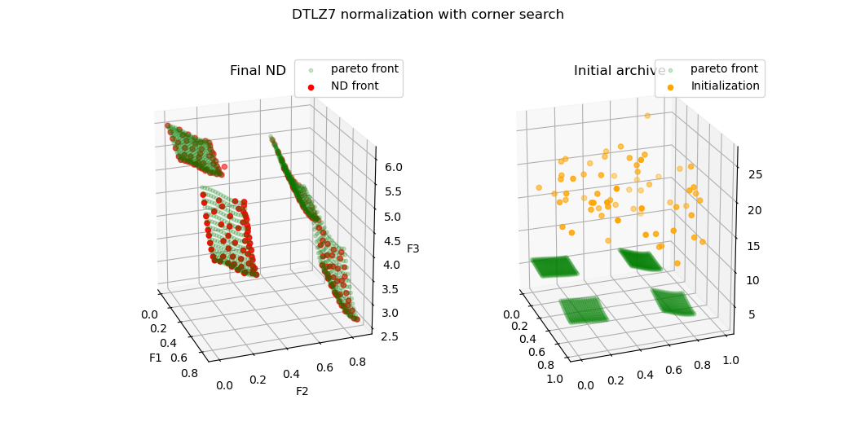
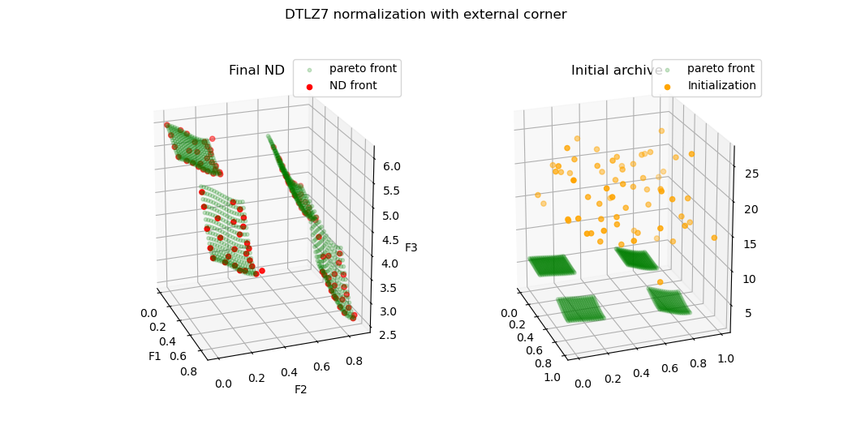

Slide 23

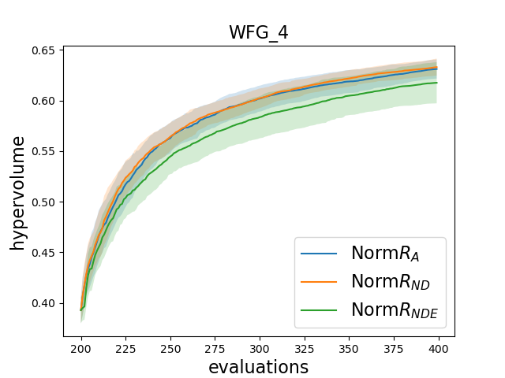
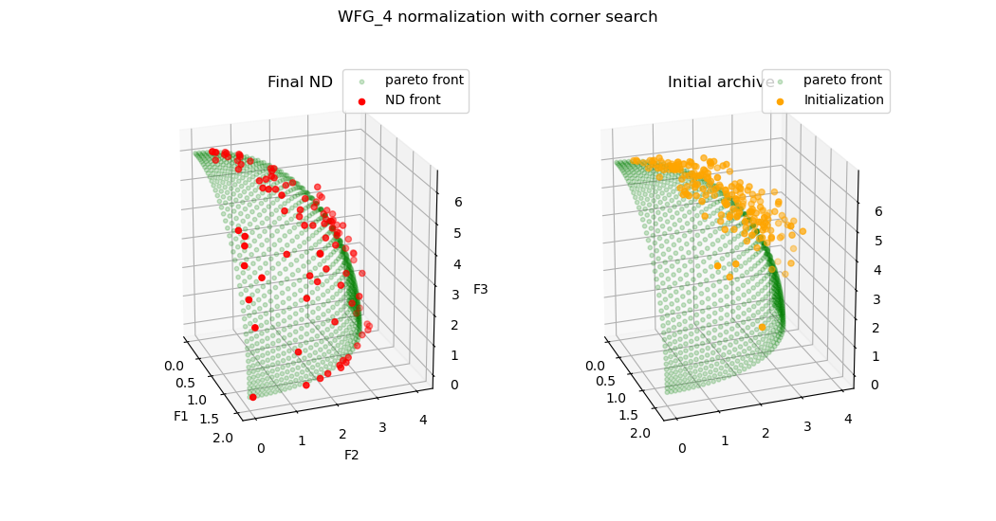

Slide 24
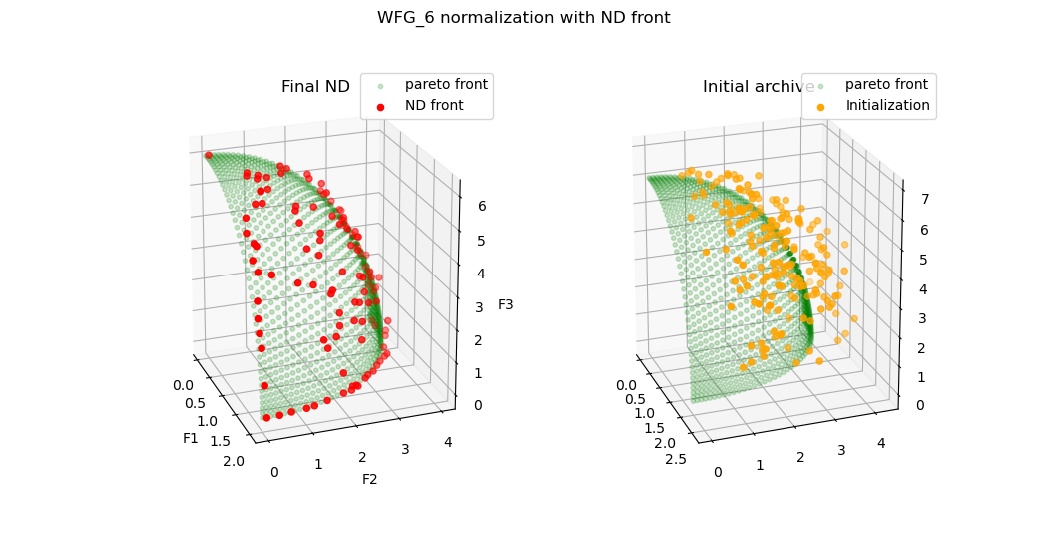
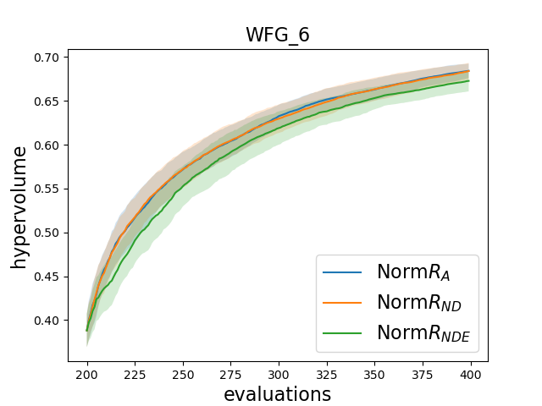


Slide 25




Slide 26
Analysis:
1. Typical improvement situation:
Nadir points needs significant adjustment
Initial ND front is restricted into a restricted region of true pareto front, while the whole initialization does not
2. Typical NO improvement situation:
Nadir distance improvement is relatively small

Slide 27



Improvement: normalization with surrogate’s corner points + current ND front
HV performance
[1] DTLZ1-3, with external search, nadir point still stays far from real nadir
Ideal performance
Nadir performance
[1]

Slide 28

[1] DTLZ1, with external search, nadir point still stays far from real nadir
DTLZ1, with external search, it seems corner points are always high on the top, and does not close to true corners. Therefore, convergence is worse than ND front
If the corner search can be more accurate, the overall performance should be improved(? X )
The above statement is wrong. The reason is corner search does not evolutionary pressure to move downward. Although ND front is finally selected but it is not pressured to move to real corners. Corner search find point of 1 objective/2 objectives, but not real corner

Slide 29


Slide 30


Slide 31
DTLZ
Real Nadir
MAF
UF
Low difficulty on objective function
Reduce 6 corner evaluation
WFG

Slide 32


Thoughts about interpolation and extrapolation?
$$F_{n}$$
Red is initial population
Corner/extreme search can then interpolate and find better solution
What if DTLZ type problem, initial ND front actually is like the left
$$F_{n}$$
For WFG problem, it is similar to extrapolation situation.
Approximation search beyond current sample boundary has no sample to support

Slide 33


Remove DRS in external search
Reduce number of variables to 3D
HV performance
On the right is the HV performance of DTLZ problems with 3 variables & 3 objectives
The third column is normalization with mixed predicted corner and real ND
improvement
HV performance
Same parameter: 3 variables & 3 objectives
The third column is normalization with ND and corner search but selective evaluation

Slide 34

Selective Evaluation on Corner solutions
Corner search procedure
Search problem:
$$f_{1}, f_{2},f_{3}, \sqrt{{f_{1}}^{2}+ {f_{2}}^{2}}\sqrt{{f_{1}}^{2}+{f_{3}}^{2}}\sqrt{{f_{2}}^{2}+{f_{3}}^{2}}$$
Silhoutte index
Key step is sorting
Select 6 corner solution
Final population
Remove DRS in population
For each fronts: corner sort
Using kmeans to create 6 clusters, from each cluster select one closest (Euclidean) to current Ideal()
[1]Moving ideal and nadir
[2]dominated
[3] Check HV improvement
Selective evaluation
Corner points
Reference point
Existing ND front
A random HV infill point

Slide 35

HV performance
First round corner search
number of variable: 6
Number of objective : 3
Budget evaluation: 300
Initialization: 200
HV performance
Selective evaluation
number of variable: 6
Number of objective : 3
Budget evaluation: 300
Initialization: 200

Slide 36


Additional experiments
1. Same setting with optimization problem more objectives
Corner search procedure: same as last slide
Corner search objective:
$$f_{1}, f_{2},f_{3}, \sqrt{{f_{1}}^{2}+ {f_{2}}^{2}}\sqrt{{f_{1}}^{2}+{f_{3}}^{2}}\sqrt{{f_{2}}^{2}+{f_{3}}^{2}}$$
HV performance
Selective evaluation
Number of variable: 6
Number of objective : 5
Budget evaluation: 400(WFG) 300(DTLZ)
Initialization: 200(WFG) 11d-1(DTLZ)

Slide 37


Additional experiments
1. Same setting with less corner search objectives
Corner search procedure: same as last slide
Corner search objective:
$$f_{1}, f_{2},f_{3},$$
HV performance
Selective evaluation
number of variable: 6
Number of objective : 3
Budget evaluation: 300(WFG) 200(DTLZ)
Initialization: 200(WFG) 11d-1(DTLZ)

Slide 38
Experimental setting:
2 objectives
3 objectives
5 objectives
10 objectives
(1) 3 objectives compare HV indicator, convergence, PF plot
(2) 5 objectives compare HV indicator, convergence, PF plot

Slide 39


MAF problems
Selective evaluation (3 corner points)
number of variable: 6
Number of objective : 3
Budget evaluation: 300
Initialization: 200
Selective evaluation (6 corner points)
number of variable: 6
Number of objective : 3
Budget evaluation: 300
Initialization: 200

Slide 40




MAF problems
Selective evaluation (6 corner points)
number of variable: 6
Number of objective : 3
Budget evaluation: 300
Initialization: 200

Slide 41




MAF problems
Selective evaluation (6 corner points)
number of variable: 6
Number of objective : 3
Budget evaluation: 300
Initialization: 200

Slide 42




MAF problems
Selective evaluation (6 corner points)
number of variable: 6
Number of objective : 3
Budget evaluation: 300
Initialization: 200

Slide 43




MAF problems
Selective evaluation (6 corner points)
number of variable: 6
Number of objective : 3
Budget evaluation: 300
Initialization: 200

Slide 44









More complete problems problems
Selective evaluation (6 corner points)
number of variable: 6
Number of objective : 3
Budget evaluation: 300
Initialization: 200(WFG) 11d-1(rest)

